Slide 1
AST 20613 Presentation
ISD 02
Computer System Development
V.Calendar (Voice Calendar)

Slide 2
AIMS of our Project
NO NEED TO USE HAND FOR
READ,CONTROL,CREATE
CALENDAR
YET BY VOICE

Slide 3
Objective
- making a voice calendar (voice input and output, voice control)
- to facilitate the use of visually-impaired users
- to provide better function based on the current calendar
- to provide more user-friendly and configurable User Interface

Slide 4
Account System
The user could register and login their account by voice.
For the voice aid users,system could run an array of automatics login procedure.
User ONLY required input their login name and password by voice guided by Voice.

Slide 5
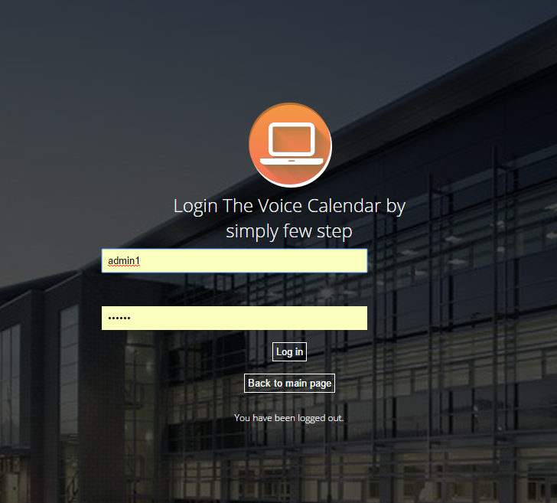
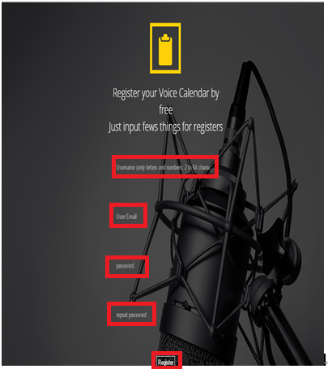

Slide 6
Voice Control
->User have could controls the system by voice.
->Certain of guidelines provided for users ‘s voice control.
->Example:Say ”Schedule” for goto schedule page.

Slide 7
Create Event
The Schedule could support using voice to edit events function.
Automatics Running an array of procedure given the users input their event.
The dates separated as yy/mm/dd/hr/min

Slide 8
Create Event
Users could input their required date by simply number or strings
Example:User input January and system converted it into 01 in month column
Users also have choices for input the date for this year or today or now.

Slide 9
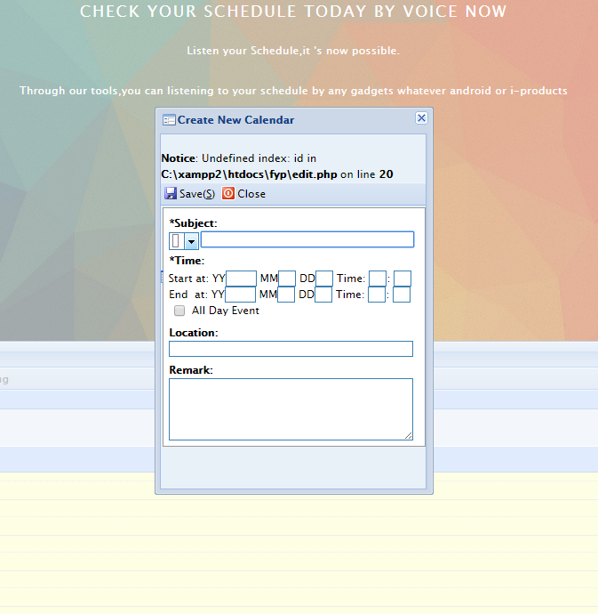
Remark:BUG that on the edit page is present since we adopt its.

Slide 10

Read Aloud Schedule
Application:
->This function relies on webkit server as script are unpredicted and too long.
->After user input the events,the datum could transmit to database.
->Loaded the datum from database and generate sounds after the current hours.
Remark:Voice Guideline could used google tts to generate soundtrack instead of webkit as well as prevent bottleneck effect happen.(In memory
computing)

Slide 11
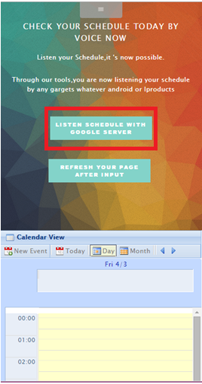

Slide 12

Email System
Assume:
->hired an administrator for managed the system development.
The users have right for asked questions and problems for using VCal:
->Calendar Event adding
->Edit the user information
The Email could send to administrator email account.

Slide 13
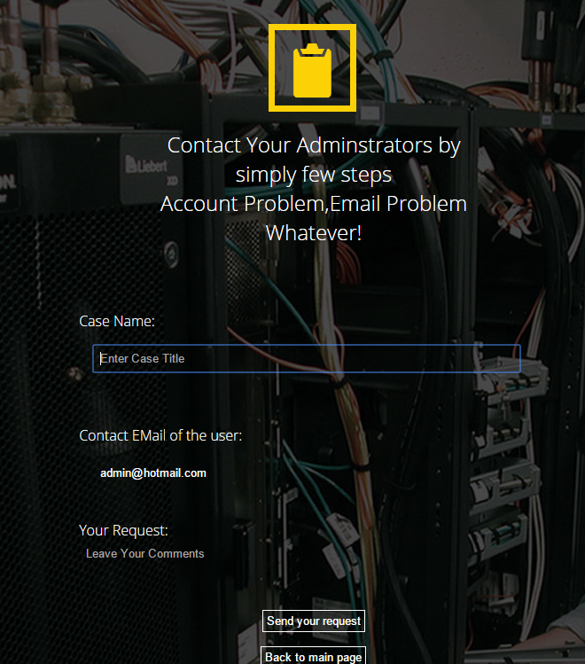
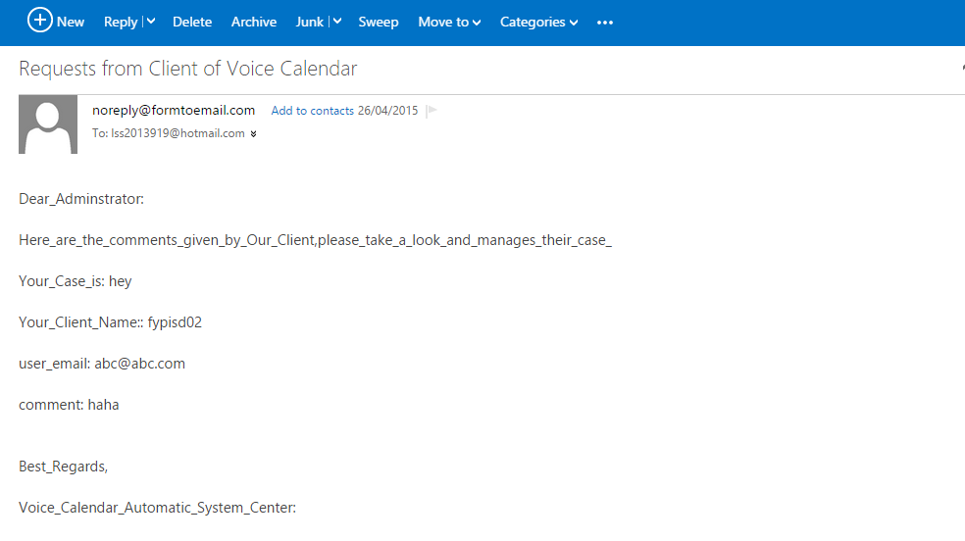

Slide 14

Administration System
The administrator have right for edit the account and delete the account of the users.
It could coordinate with the timetable for appropriate users.
The Administrator system could also support dump function.

Slide 15
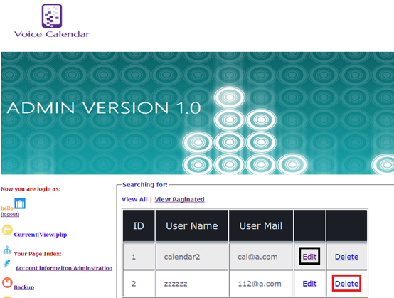
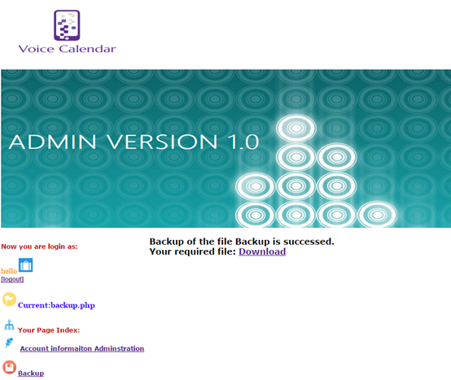

Slide 16
Check personal information
While users speak “info” or click information button,
The system could read aloud and show the information since users registered.
The system could automatics back to main page after read aloud.

Slide 17
